Slide 1
PRESENTATION ON VEHICLE RESALE VALUE PREDICTION
BY
N.DURGALAKSHMI PRASANNA
P.SANDHYA
N.RESHMA
T.KEERTHI REDDY
T.SALEEM

Slide 2
INTRODUCTION
Machine learning is an application of artificial intelligence (AI) that provides systems the ability to automatically learn and improve from experience without being explicitly programmed.
Machine learning combines data with statistical tools to predict an output.
The used car market is a large and strategically important market for car manufacturers.
The second-hand market is closely connected to the new car business.

Slide 3
ABOUT MODEL
Multiple linear regression (MLR): is a statistical technique that uses several explanatory variables to predict the outcome of a response variable.
The Formula for Multiple Linear Regression Is:
yi​=β0​+β1​xi1​+β2​xi2​+...+βp ​xip​+ϵ
Predicting the resale value of a car is not a simple task. It is trite knowledge that the value of used cars depends on a number of factors.
Vehicle Type | yearOf Registration | Gear Box | kilometer | notRepairedDamage | fuelType | monthOf Registration | brand | price
kombi | 1993 | Manual | 150000 | yes | petrol | 0 | volkswagen | 480000
coupe | 2011 | Manual | 125000 | yes | diesel | 5 | audi | 183000

Slide 4
METHODOLOGY
Importing the Libraries
Importing the Dataset
Encoding Categorical Data
Splitting the Dataset
Fitting Multiple Linear Regression to the Training set
Predicting the Test Set Results
Visualize the model
Run the code in watson studio
Construct the flow in NodeRed and predict the value.

Slide 5
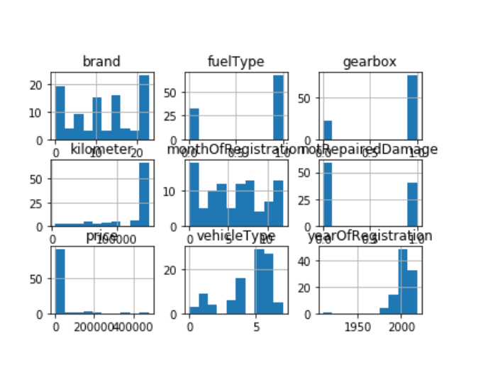
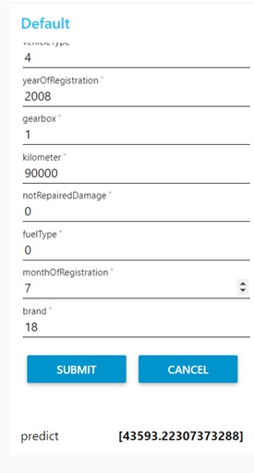
Visualization & prediction

Slide 6
CONCLUSION
Resale of used car price prediction can be a challenging task due to the high number of attributes that should be considered for the accurate prediction. The major step in the prediction process is collection and preprocessing of the data.

Slide 7
THANK YOU

